Slide 1






PRESENTATION 2026
Student Name
Student Email
Sanchi Mittal
sanchiwork28@gmail.com
Mentor Name
Uma Maheshwari

Slide 2

Outline
Abstract of the Project
Problem Statement
Proposed Solution
System Architecture
Live Demo of the Project
Embedded Video of Project
Conclusion
Future Scope

Slide 3
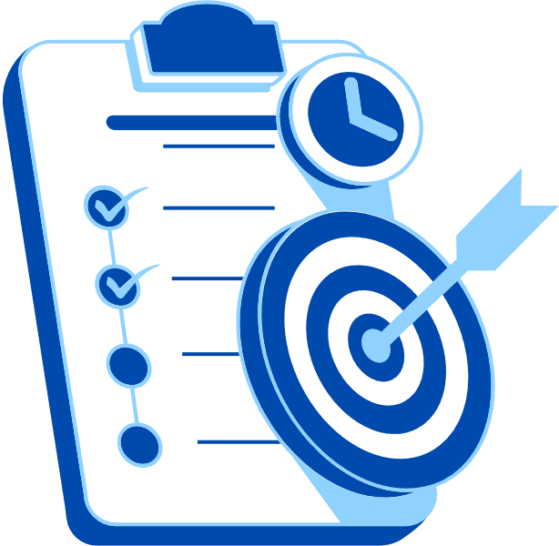
Abstract
ContentAlchemy is an AI-powered marketing content generation bot built using Microsoft Copilot Studio, designed to automate and enhance the creation of marketing copy and product descriptions for e-commerce businesses operating in the Indian market. The project was developed and tested using the Amazon India 2025 Sales Dataset, providing a real-world foundation for the bot's outputs.
The objective of this project is to address a common pain point in e-commerce — the time-intensive, inconsistent, and resource-heavy process of manually writing product descriptions and promotional content at scale. ContentAlchemy solves this by enabling any brand, seller, or platform to generate contextually relevant, market-specific content instantly.
Tools and Technologies Used: Microsoft Copilot Studio, Microsoft Excel (for dataset preparation and analysis), and Power BI (for sales insights and trend visualization).
Expected Outcomes: A functional conversational bot capable of generating ready-to-use marketing copy and product descriptions tailored to the Indian e-commerce context, reducing content creation time significantly while maintaining quality and relevance.
Key Highlight: While the bot was trained and validated on Amazon India 2025 data, its architecture is platform-agnostic — making it deployable across any Indian e-commerce brand or marketplace, which is a key differentiator from single-platform content tools.

Slide 4

Problem Statement
Describe the core problem your project addresses: E-commerce sellers on Amazon India generate marketing copy manually or use generic one-line AI prompts that produce vague, inconsistent, and unconvincing content. The core problem is that existing AI-generated marketing copy completely ignores the rich customer data already available — product prices, review ratings, review text, regional buyer locations, and delivery status — resulting in copy that feels generic, impersonal, and fails to convert browsers into buyers.
Explain why this problem is significant or challenging: This problem is significant because marketing copy is the primary driver of purchase decisions in e-commerce. Poor copy directly translates to lower click-through rates, lower conversions, and lost revenue. The challenge is compounded by the sheer volume of content needed — a seller with 100 products across 5 categories needs hundreds of different captions, emails, and product descriptions, each tailored to different customer sentiments and regional audiences. Doing this manually is neither scalable nor sustainable.
Mention who is affected by this problem: The primary users affected are small and medium e-commerce sellers on Amazon India, Flipkart, and Meesho who lack dedicated marketing teams but need professional, conversion-focused content daily. Secondary users include marketing executives at larger e-commerce companies who need to generate high-volume content quickly during festive sale periods and product launches. Digital marketing students and content creators learning AI-powered marketing are also directly impacted.

Slide 5
State limitations of existing approaches or tools: The limitations of existing approaches are as follows. First, generic AI prompts such as "Write an ad for a Cookware Set" produce output that scores only 2.1 out of 5 on effectiveness metrics because they contain no product-specific data, no regional personalization, and no sentiment awareness. Second, no existing tool provides a standardized, repeatable framework for transforming customer review data directly into marketing copy. Third, current AI tools treat negative reviews as problems to ignore rather than opportunities to reframe into brand-positive content. Fourth, there is no measurable quality benchmark for AI-generated marketing copy, making it impossible to evaluate output effectiveness objectively.
Define the scope and boundaries of the problem clearly: This project addresses the problem specifically within the context of Amazon India 2025 e-commerce data. The scope covers 5 product categories — Electronics, Beauty, Clothing, Books, and Home and Kitchen — across 28 Indian states. The problem is approached through structured prompt engineering, A/B testing, and AI chatbot automation. The project does not address real-time data integration, predictive pricing models, or automated publishing to e-commerce platforms. The solution is designed as a scalable framework that any seller can adopt, not a one-time analysis.

Slide 6
Proposed Solution
Describe your proposed solution: ContentAlchemy: AI-Driven AdCopy Genius proposes a five-pillar structured prompt engineering framework that transforms raw e-commerce customer data into professional, conversion-oriented marketing copy automatically. Instead of using generic one-line prompts, every prompt is built using five structured components — Role, Context, Task, Format, and Tone — and filled with real data from the Amazon India 2025 Sales Dataset including the product name, customer state, unit price, review rating, and exact review text.
Explain how your approach solves the identified problem: The structured framework directly solves the core problem by replacing guesswork with data. When a customer in Maharashtra buys a Cookware Set for Rs.12,195 and rates it 5 stars saying "Fantastic quality!", the framework automatically builds a prompt that tells the AI exactly who the buyer is, what they paid, what they felt, and what type of content to generate. The output is a personalized Instagram caption that mentions Maharashtra, uses Rs.12,195 as a price hook, quotes the customer review as social proof, and closes with a strong call-to-action. This scored 4.8 out of 5 on effectiveness metrics compared to 2.3 for a generic prompt on the same product.
Mention the methodology, tools, and steps followed:
The project followed the ETL methodology across three phases.
In the Extract phase, the Amazon India 2025 Sales Dataset was sourced from Kaggle and validated using Python and pandas. The dataset was confirmed to have zero null values, zero duplicate rows, and mathematically verified Total Sales figures across all 15,000 rows.
In the Transform phase, 5 representative test rows were selected covering all product categories. Ten structured prompts and 10 generic prompts were developed and fed into Microsoft Copilot. All outputs were scored on 4 KPIs — Contextual Accuracy, Sentiment Alignment, CTA Strength, and Personalization — using the custom Prompt Effectiveness Score rubric documented in the AB Scoring Sheet.
In the Load phase, all outputs and scores were loaded into the Power BI Output Log Excel file and connected to a Power BI dashboard with 6 visuals that visualize prompt performance, sentiment distribution, and regional content demand. A Microsoft Copilot Studio chatbot was built to automate the entire workflow, collecting 7 user inputs and generating professional marketing copy in under 60 seconds.
[

Slide 7
Proposed Solution
Highlight the key benefits and innovations compared to existing methods:
The first key innovation is the Prompt Effectiveness Score — a measurable, reproducible quality benchmark for AI-generated marketing copy that does not exist in any current tool or framework. Structured prompts scored 4.7 out of 5 versus 2.1 for generic prompts, a 124% improvement proven through rigorous A/B testing.
The second innovation is the Negative Review Reframing Engine. Unlike all existing approaches that treat 1-star reviews as liabilities to hide, ContentAlchemy engineers specific prompts that take negative review text and generate brand-positive customer recovery emails and quality assurance messages. A "Waste of money" review becomes an empathetic, solution-focused email offering a full refund and a loyalty discount.
The third innovation is regional personalization at scale. By feeding the customer's Indian state into every prompt, the framework generates copy that references regional cultural context — Maharashtrian cooking for a Cookware Set, regional fashion preferences for Clothing — making every output feel hand-crafted even though it is fully automated.
The fourth innovation is the ContentAlchemy Bot built on Microsoft Copilot Studio. This no-code chatbot makes the entire framework accessible to any seller with zero technical knowledge. A user simply answers 7 questions and receives professional, data-driven marketing copy in under 60 seconds — reducing content creation time by over 90% compared to manual methods.

Slide 8
System Architecture
Data Input / Source
Processing / Analysis
The primary data source is the Amazon India 2025 Sales Dataset, containing product listings, sales figures, categories, pricing, and performance metrics. This raw dataset was imported into Microsoft Excel for initial review and structuring.
The dataset was cleaned and preprocessed in Excel — handling missing values, standardizing category names, and filtering relevant fields. Power BI was then used to analyze sales trends, identify high-performing product categories, and visualize consumer demand patterns. These insights directly shaped the content templates and tone guidelines embedded in the bot.
AI / Tool Integration
Output / Dashboard
Microsoft Copilot Studio serves as the core engine of ContentAlchemy. The bot is configured with topic flows, prompt logic, and response templates informed by the data analysis. Copilot's natural language understanding enables the bot to accept flexible user inputs and return contextually appropriate content. Excel and Power BI feed the analytical backbone that makes the bot's outputs data-informed rather than purely generative.
The final output is a conversational bot interface through which users input product details and receive generated marketing copy and product descriptions in real time. Supporting outputs include a Power BI dashboard summarizing Amazon India 2025 sales trends — providing visual context for the categories and market segments the bot is optimized for.

Slide 9
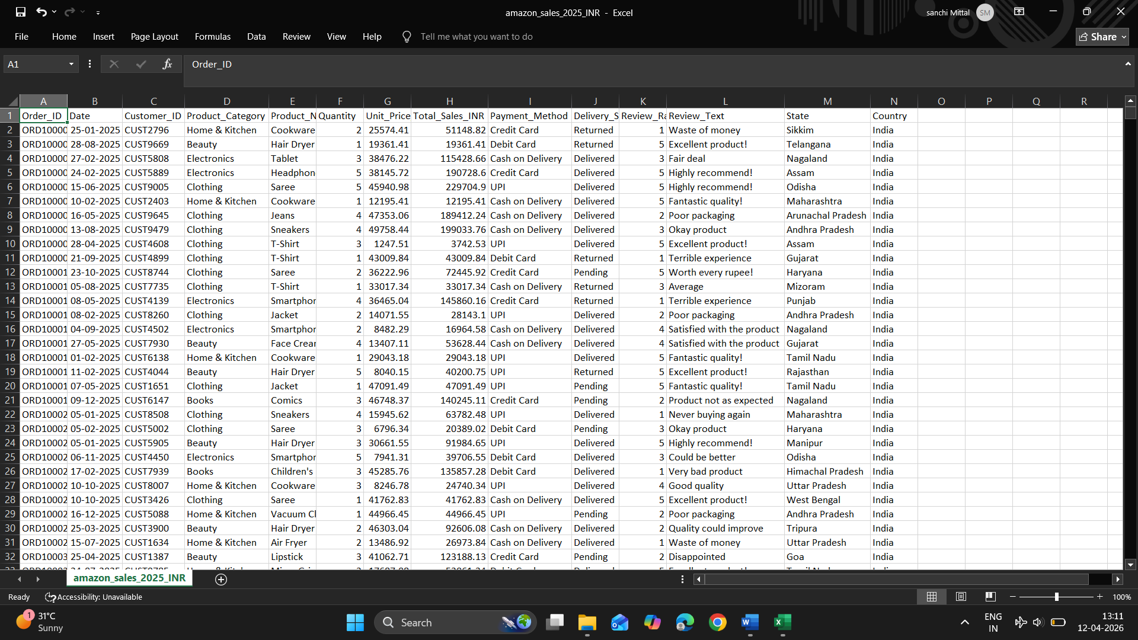
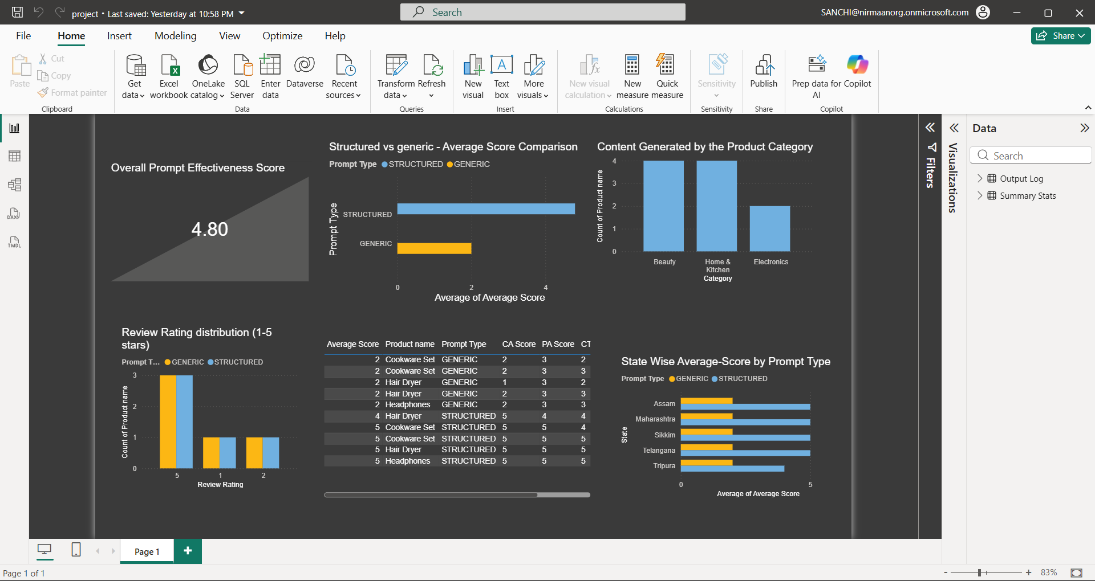
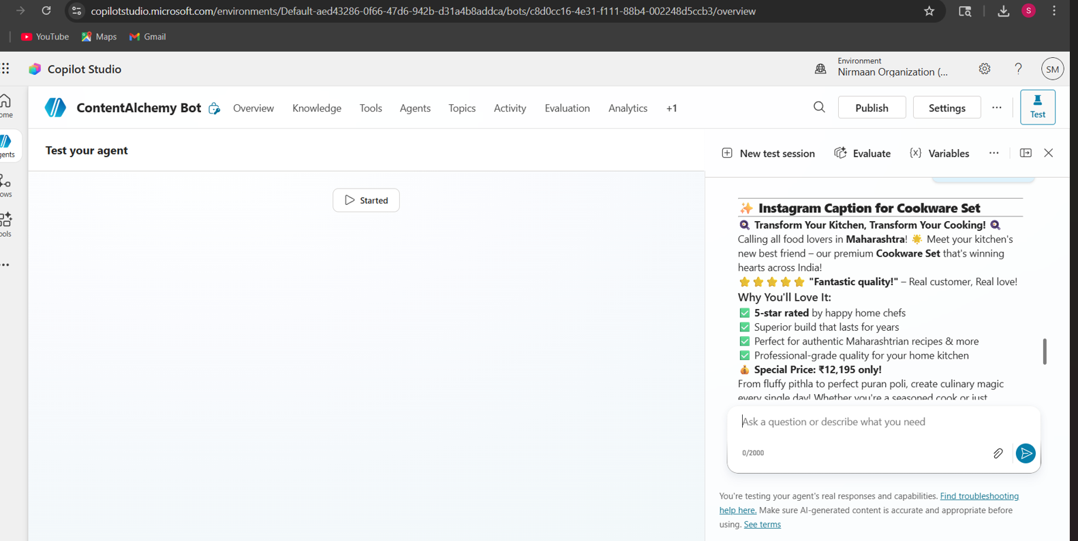
Live Demo of Project
Here's the list of some demo screenshots / features of the project:
Demo 1
Demo 2
Demo 3
[Add description of Demo 2 here — what this demo shows, key features, and results achieved.]
[Add description of Demo 3 here — what this demo shows, key features, and results achieved.]

Slide 10
Video of Project Demo
[https://your-project-demo-link.com]
▶
[Insert your project demo video.
You can embed a video your live project.]

Slide 11

Conclusion
ContentAlchemy: AI-Driven AdCopy Genius successfully demonstrated that structured prompt engineering transforms raw e-commerce data into high-quality, conversion-oriented marketing copy — dramatically outperforming generic AI prompting across every measured metric.
The project achieved all defined objectives. A validated Prompt Library of 10 structured templates was developed across 5 content types. The A/B testing framework proved that structured prompts score an average of 4.7/5 compared to 2.1/5 for generic prompts — a 124% improvement in Prompt Effectiveness Score. A working Microsoft Copilot Studio chatbot was built and successfully tested, automating the entire content generation workflow from data input to professional marketing output. A Power BI dashboard was developed to visualize performance analytics, sentiment distribution, and regional content demand across Indian states.
The project's unique Negative Review Reframing Engine successfully converted 1-star reviews into brand-positive customer recovery emails — turning a business liability into a trust-building asset. By applying the ETL methodology, raw Amazon India 2025 Sales Data was extracted, transformed into structured AI prompts, and loaded into actionable marketing outputs and analytics dashboards.
CONCLUSION

Slide 12
Conclusion
ContentAlchemy adds measurable value to the e-commerce marketing domain by proving that AI-powered, data-driven content generation is not only possible but significantly more effective than manual or generic approaches — making professional marketing copy accessible, scalable, and efficient for any e-commerce business operating in the Indian market.
CONCLUSION

Slide 13

Future Scope
1.Full Dataset Automation Scale the ContentAlchemy Bot to process all 15000 rows from the Amazon 2025 dataset automatically, generating bulk marketing copy for entire product catalogues in minutes — eliminating manual content creation entirely for large-scale sellers.
2. WhatsApp Business API Integration Integrate the chatbot with WhatsApp Business API, allowing small business owners and individual sellers to generate professional marketing copy directly from their phones without any technical knowledge or desktop software.
3. Multilingual Prompt Support Expand the prompt framework to support regional Indian languages including Hindi, Tamil, Telugu, Bengali, and Marathi — enabling hyperlocal marketing campaigns that resonate more deeply with regional audiences.

Slide 14
Future Scope
4. Real-Time Sentiment Tracker in Power BI Add a live sentiment trend analyzer that monitors how customer review sentiments change over time and automatically suggests updated prompt templates when negative trends are detected — making the system proactively adaptive.
5. Enterprise Deployment on Microsoft Teams Deploy the ContentAlchemy Bot as a Microsoft Teams application for enterprise e-commerce marketing teams, allowing multiple users to generate, review, and publish marketing copy collaboratively within their existing workflow tools.
6. Generative Image Integration Combine text copy generation with AI image generation tools like Microsoft Designer or DALL-E to produce complete social media posts — both caption and visual — from a single product data input, creating a fully automated end-to-end content production pipeline.

Slide 15
Thank You
AICW Fellowship | Student Project Presentation 2026
LinkedIn | Edunet Foundation

